Slide 1

Uber Trip Analysis Report
This report provides a detailed analysis of insights gathered from the Uber trip data dashboard Created Using power BI. It aims to deliver a comprehensive understanding of key trends, opportunities, and actionable recommendations to optimize Uber's operations, enhance customer satisfaction, and drive revenue growth. The analysis focuses on booking patterns, payment preferences, trip efficiency, and customer behavior.

Slide 2
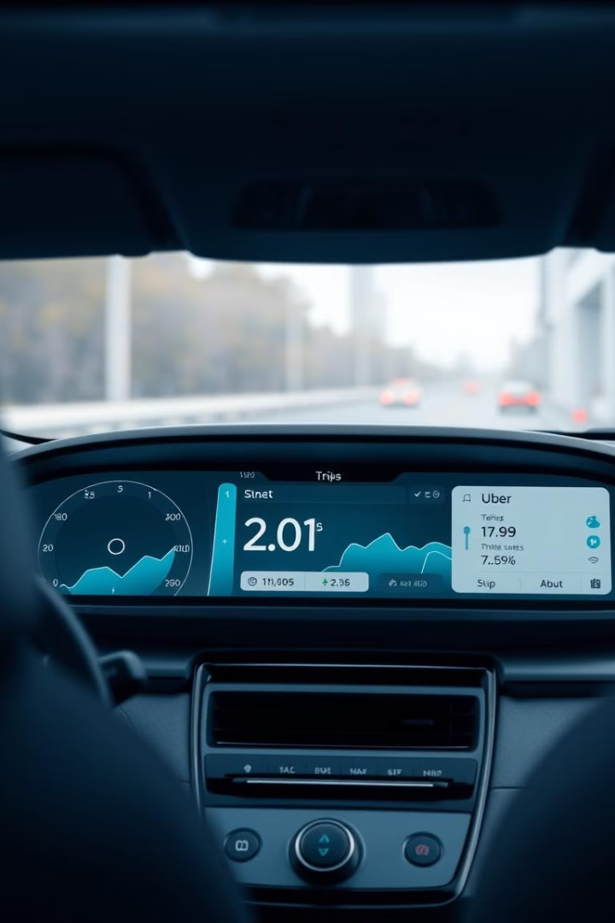
Uber Trip Analysis Report
This report evaluates trip data from Uber's operations, focusing on key metrics such as booking trends, payment preferences, trip efficiency, and customer behavior. The goal is to identify actionable insights for optimizing operations, enhancing customer satisfaction, and increasing revenue.

Slide 3
Key Metrics
2.1 Operational Performance
Total Bookings: 103.7K trips within a month demonstrate strong demand.
Total Booking Value: $1.6M, with an average booking value of $15.
Trip Efficiency:
Average Trip Distance: 3 miles.
Average Trip Time: 16 minutes.
Observations: Short, intra-city commutes dominate.
2.2 Payment Preferences
Uber Pay: Dominates with 84.35%, but Amazon Pay contributes significantly to revenue (62.48% of total booking value).
Cash Transactions: Account for 12.93%, indicating reliance on traditional payment methods.
Digital Wallet Adoption: Limited usage of Google Pay (0.95%) and Amazon Pay (1.65%).

Slide 4
Temporal Trends
3.1 Daily Patterns
Most Active Day: Friday leads with 18.7K bookings, indicating peak usage before weekends.
Least Active Day: Thursday, with only 2.5K bookings.
3.2 Hourly Trends
Peak Booking Hours: 3:00 PM shows the highest activity, aligning with late-afternoon travel demands.
Low Activity Periods: Early mornings present a growth opportunity for incentivized travel options.
3.3 Heatmap Insights
High demand during afternoon and early evening hours, especially on weekends, highlights opportunities for better fleet allocation during these times.

Slide 5
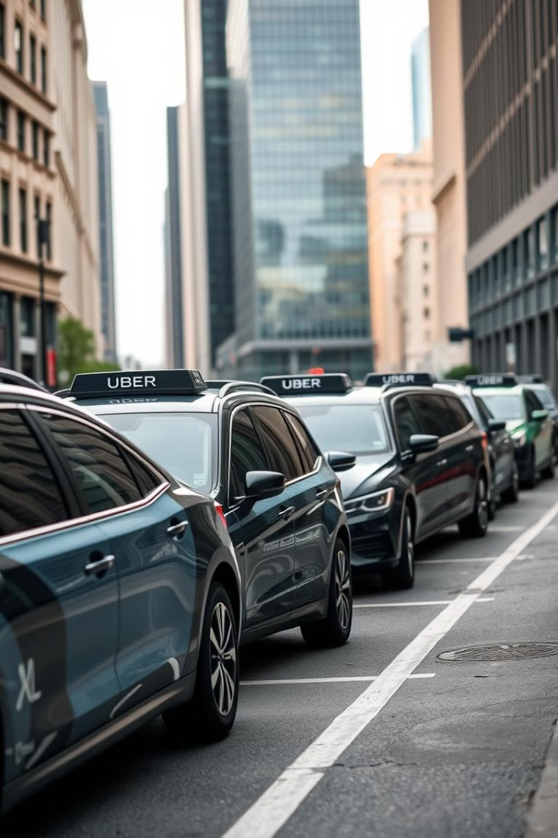
Vehicle Type Analysis
UberX: The most popular option, contributing the highest number of trips (39K) and revenue ($583,880). Preferred for its affordability.
UberXL and Uber Black: Generate significant revenue from fewer bookings, reflecting a niche market for premium services.
Uber Green: Limited adoption (14,498 trips), signaling untapped potential in eco-friendly ride options.

Slide 6
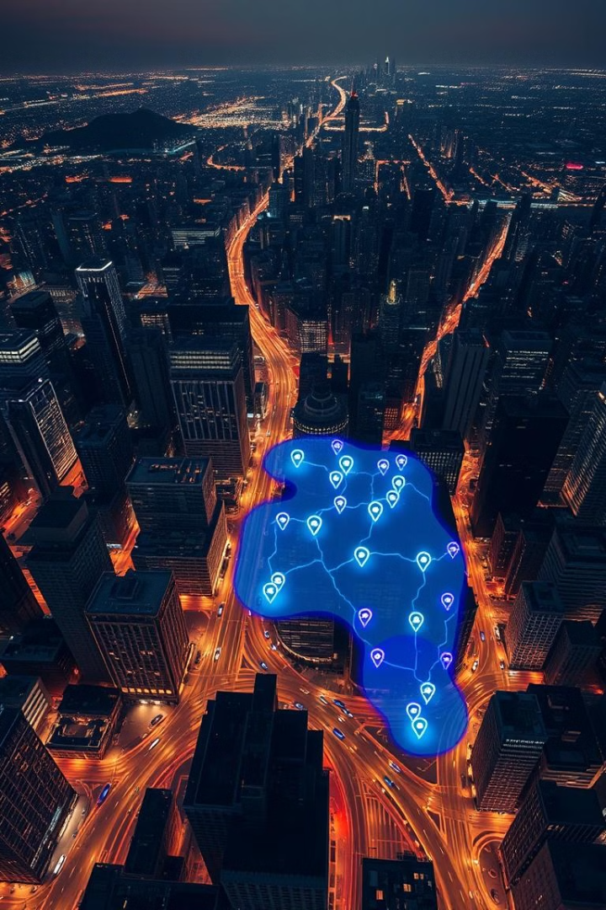
Location Insights
Top Pickup Location: Penn Station/Madison Sq West is the busiest hub, likely due to its central location.
Top Drop-off Location: Upper East Side North leads, potentially reflecting residential or affluent customer segments.
Longest Trip: 144.1 miles (Lower East Side → Crown Heights North), highlighting rare instances of long-distance travel.

Slide 7
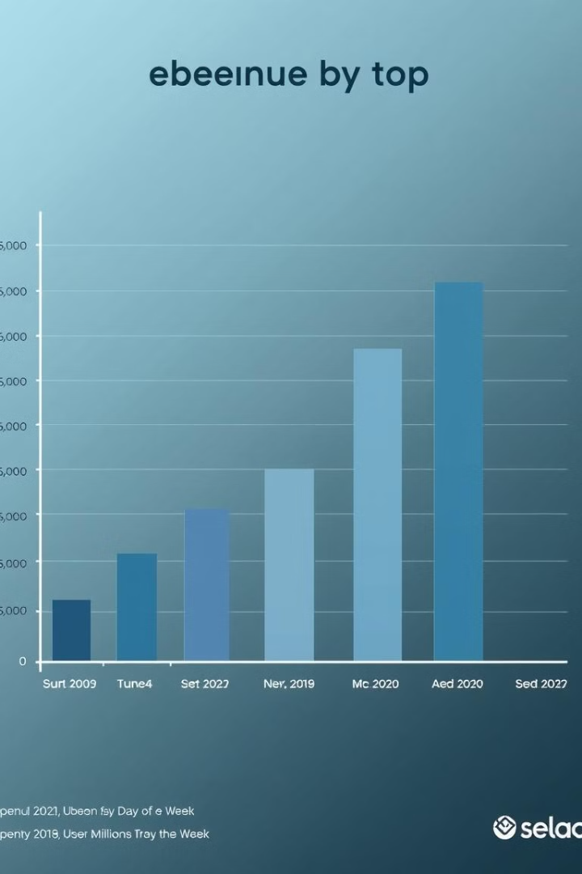
Revenue Insights
Fridays and Sundays generate the highest booking values ($276K and $283K, respectively). Midweek days like Tuesday and Wednesday show lower revenue, presenting an opportunity for targeted promotional strategies.

Slide 8
Opportunities for Growth
7.1 Payment Methods
Promote Digital Payments: Campaigns offering cashback for Google Pay and Uber Pay could encourage greater adoption.
Reduce Cash Dependency: Discounts or convenience-driven marketing can further transition cash users to digital options.
7.2 Temporal Optimization
Expand Night Operations: Safety measures, discounts, or partnerships with nightlife venues could increase bookings during nighttime hours.
Balance Weekday Usage: Midweek campaigns can help drive usage on slower days like Tuesday and Thursday.
7.3 Vehicle and Customer Segments
Eco-Friendly Options: Increase awareness and incentives for Uber Green to attract environmentally conscious users.
Premium Services: Promote UberXL and Uber Black during special events or among business travelers.
7.4 Heatmap Utilization
Use peak demand patterns to optimize driver and vehicle allocation, ensuring better customer experience and operational efficiency.

Slide 9
Strategic Recommendations
8.1 Marketing Strategies
Dynamic Pricing: Use demand patterns to implement surge pricing during peak hours and discounts during off-peak times.
Location-Based Offers: Partner with businesses near high-traffic areas like Penn Station for mutual promotions.
8.2 Customer Retention
Loyalty Programs: Reward frequent users with discounts for consistent usage during low-demand periods.
Personalized Offers: Leverage data on travel times and payment preferences to create tailored campaigns.
8.3 Driver Incentives
Offer bonuses for drivers operating during off-peak hours to ensure adequate fleet coverage and reduce wait times.
8.4 Long-Term Goals
Develop strategies to educate and attract customers to eco-friendly rides. Utilize subscription-based models for frequent travelers to ensure consistent revenue streams.

Slide 10
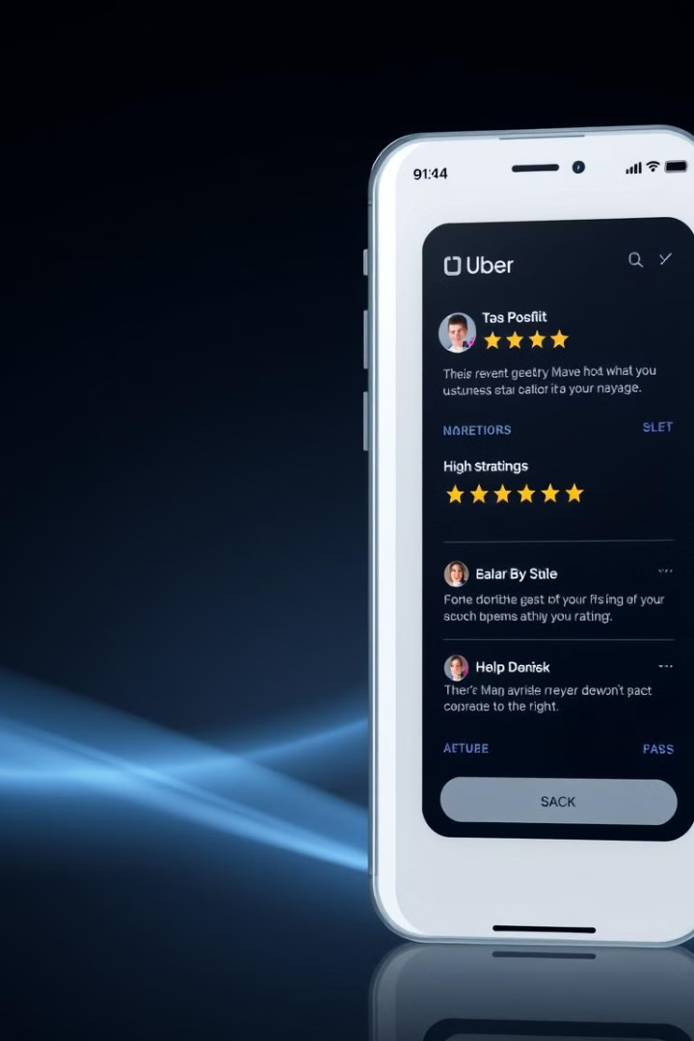
Conclusion
The dashboard reveals several growth opportunities, especially in enhancing digital payment adoption, expanding nighttime services, and optimizing fleet management during peak hours. These insights, if strategically implemented, can boost customer satisfaction, operational efficiency, and overall revenue.

